Slide 1
计算机网络原理与编程
主讲：张召

Slide 2

主讲老师简介
张召 长期从事区块链系统和分布式数据库方面的教学和研究。
邮件：zhzhang@dase.ecnu.edu.cn
电话、微信：18502118359
课程钉钉群，作业提交，讲义分发等

Slide 3
主要学习内容
面向Internet网络，学习其工作原理和运行机制。
协议，HTTP，DNS，TCP/UDP，.....
WireShark协议分析软件
网络编程
以JAVA语言为依托，学习网络编程
为后续的分布式系统开发打基础

Slide 4
学习方式
理论学习结合上机实践
上机实践：网络协议分析（Wireshark）和编程（Java网络编程）并重

Slide 5
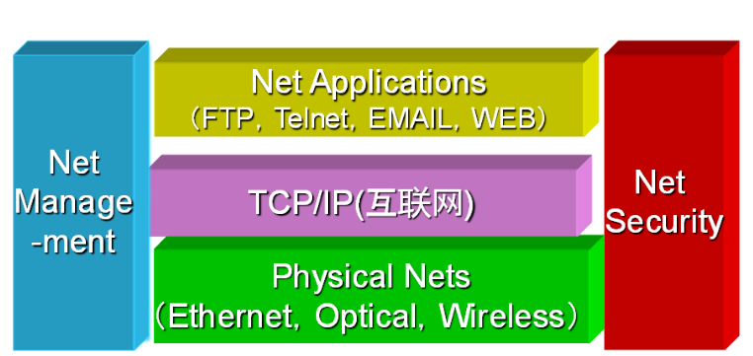
什么是计算机网络
利用通信信道，将地理上分布的多个计算机系统连接起来，在相应网络协议的支持下，实现信息传送、资源共享和网络计算功能的系统。
Notes:
TCP/IP的全称是TCP/IP Protocol Suite或TCP/IP Protocols。 其中TCP是Transmission Control Protocol，传输控制协议；IP是Internet Protocol Address，互联网协议地址。

Slide 6
计算机网络的功能
信息传递
传送文本、图像、视频、声音
共享资源
信息资源、计算资源、存储资源
网络计算
分布在不同地点的多台计算机共同完成一定的任务

Slide 7
课程目标
我们专业和网络工程，通讯工程等专业学习网络的切入点有什么不同？
学习支撑互联网的核心关键技术及其工作原理
为将来从事分布式系统相关的学习和工作打下基础。

Slide 8
教材和参考资料
教材：
James F. Kurose, Keith W. Ross(陈鸣 译)，计算机网络自顶向下方法（原书第7版），机械工业出版社，2018。
参考书：
Andrew S．Tanenbaum（严伟、潘爱民译），计算机网络（第五版），清华大学出版社，2012

Slide 9
思考问题
如果让你来为某个学校建设一个校园网，你需要做哪些事情，包含几个步骤？
什么是协议（protocol）？
通信计算机双方必须共同遵从的一组约定。如怎么样建立连接、怎么样互相识别等。只有遵守这个约定，计算机之间才能相互通信交流。

Slide 10
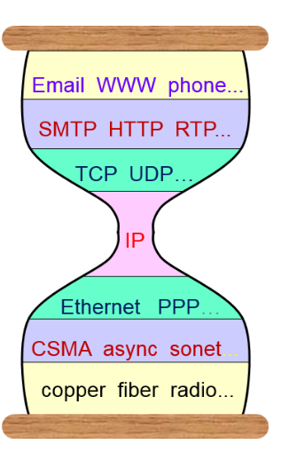
课程主要内容
第一章 计算机网络和因特网
网络核心、边缘、协议的体系结构
第二章 应用层
Http、电子邮件（SMTP，POP3）、
DNS等协议
第三章 运输层
主机上的进程之间提供了可靠、有效的报文传送服务（TCP，UDP）

Slide 11
课程主要内容
第四章 网络层：数据平面
路由器工作原理、IPV4、IPV6编址
第五章 网络层：控制平面 I
路由选择算法，SDN控制平面
第六章 链路层和局域网
差错检测和纠正、多访问链路
IP层
Notes:
everything over IP 和IP over everything
两个端系统之间的数据透明传送，具体功能包括寻址和路由选择、连接的建立、保持和终止等。
链路层：如何将数据组合成数据块，在数据链路层中称这种数据块为帧，帧是数据链路层的传送单位；如何控制帧在物理信道上的传输，包括如何处理传输差错，如何调节发送速率以使与接收方相匹配；以及在两个网络实体之间提供数据链路通路的建立、维持和释放的管理。
物理层规定:为传输数据所需要的物理链路创建、维持、拆除，而提供具有机械的，电子的，功能的和规范的特性。

Slide 12
高级专题
第七章 无线网络和移动网络
第八章 计算机网络中的安全
第九章 多媒体网络

Slide 13
对同学们的要求
认真上课
勤于思考
勇于实践
乐于交流

Slide 14
考核方式
平时成绩40%~50%
课堂表现、作业和上机实践
期末闭卷考试 60%~50%

Slide 15
Chapter 1: introduction
our goal:
get “feel” and terminology（术语）
more depth, detail later in course
approach:
use Internet as example
overview:
what’s the Internet?
what’s a protocol（协议）?
network edge（边缘）; hosts（主机）, access net, physical media
network core: packet/circuit（分组/电路） switching, Internet structure
performance: loss（丢包）, delay（时延）, throughput（吞吐）
security
protocol layers, service models
history

Slide 16
Chapter 1: roadmap
1.1 what is the Internet（国际互联网）?
1.2 network edge（网络边缘）
end systems, access networks（接入网）, links
1.3 network core（网络核心）
packet switching（分组交换）, circuit switching（电路交换）, network structure
1.4 delay（时延）, loss（丢包）, throughput（吞吐） in networks
1.5 protocol layers, service models
1.6 networks under attack（网络攻击）: security
1.7 history

Slide 17




















What’s the Internet: “nuts and bolts” view 具体构成的角度看
PC
billions of connected computing devices:
hosts（主机） = end systems（端系统）
running network apps
mobile network
server
wireless
laptop
global ISP
smartphone
home
network
通信链路
光纤,同轴电缆 , 无线电等
传输速率bit/s: bandwidth(带宽)
regional ISP
wireless
links
wired
links
packet switches（分组交换机）: forward packets (chunks of data)
routers（路由器） and switches（交换机）
router
institutional
network
Notes:
ISP (Internet Service Providers，Internet提供商)

Slide 18






“Fun” Internet-connected devices
Web-enabled toaster +
weather forecaster
IP picture frame
http://www.ceiva.com/
Tweet-a-watt:
monitor energy use
Slingbox: watch,
control cable TV remotely
sensorized,
bed
mattress
Internet
refrigerator
Internet phones

Slide 19
What’s the Internet: “nuts and bolts” view
Internet: “network of networks”
Interconnected ISPs
protocols control sending, receiving of messages
e.g., TCP, IP, HTTP, Skype, 802.11
Internet standards
RFC: Request for comments RFC始于1969年，由当时UCLA的Stephen D. Crocker用来记录有关ARPANET开发的非正式文档，最终演变为用来记录互联网规范、协议、过程等的标准文件。
IETF: Internet Engineering Task Force（互联网工程应用组），始于1986年的IETF是推动Internet标准规范制定的最主要的组织。
mobile network
global ISP
home
network
regional ISP
institutional
network
Notes:
最初的“阿帕网”，由西海岸的4个节点构成。

Slide 20
What’s the Internet: a service view
mobile network
infrastructure（基础设施） that provides services to applications:
Web, VoIP, email, games, e-commerce, social nets, …
provides programming interface to apps
hooks that allow sending and receiving app programs to “connect” to Internet
provides service options, analogous to postal service
global ISP
home
network
regional ISP
institutional
network

Slide 21
What’s a protocol?（什么是协议？）
human protocols:
“what’s the time?”
“I have a question”
introductions
… specific messages sent
… specific actions taken when messages received, or other events
network protocols:
machines rather than humans
all communication activity in Internet governed by protocols
protocols define format, order of messages sent and received among network entities, and actions taken on message transmission, receipt

Slide 22



What’s a protocol?
a human protocol and a computer network protocol:
Hi
TCP connection
request
Hi
TCP connection
response
Got the
time?
Get http://www.awl.com/kurose-ross
2:00
<file>
time
Q: other human protocols?

Slide 23
Chapter 1: roadmap
1.1 what is the Internet?
1.2 network edge
end systems, access networks, links
1.3 network core
packet switching, circuit switching, network structure
1.4 delay, loss, throughput in networks
1.5 protocol layers, service models
1.6 networks under attack: security
1.7 history

Slide 24
A closer look at network structure:
network edge（网络边缘）:
hosts: clients and servers
servers often in data centers
mobile network
global ISP
access networks, physical media（物理媒介）: wired, wireless communication links
home
network
regional ISP
network core（网络核心）:
interconnected routers
network of networks
institutional
network

Slide 25
Access networks and physical media
Q: How to connect end systems to edge router?
residential access nets
institutional access networks (school, company)
mobile access networks
keep in mind:
bandwidth (bits per second) of access network?
shared or dedicated?

Slide 26
Access network: digital subscriber line (DSL)（数字用户线）
central office
telephone
network
DSL
modem
splitter
DSLAM
ISP
voice, data transmitted
at different frequencies over
dedicated line to central office
DSL access
multiplexer
use existing telephone line to central office DSLAM（数字用户线接入复用器）
data over DSL phone line goes to Internet
voice over DSL phone line goes to telephone net
< 2.5 Mbps upstream transmission rate (typically < 1 Mbps)
< 24 Mbps downstream transmission rate (typically < 10 Mbps)
Notes:
splitter 分配器

Slide 27
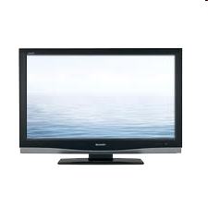
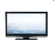

Access network: cable(电缆)network
cable headend
…
cable
modem
splitter
C
O
N
T
R
O
L
V
I
D
E
O
V
I
D
E
O
V
I
D
E
O
V
I
D
E
O
V
I
D
E
O
V
I
D
E
O
D
A
T
A
D
A
T
A
1
2
3
4
5
6
7
8
9
Channels
frequency division multiplexing(频分复用): different channels transmitted
in different frequency bands（频段）

Slide 28
Access network: cable(电缆) network
cable headend
…
cable
modem
splitter
CMTS
cable modem
termination system
data, TV transmitted at different
frequencies over shared cable
distribution network
ISP
HFC: hybrid fiber coax（混合光纤同轴）
asymmetric: up to 30Mbps downstream transmission rate, 2 Mbps upstream transmission rate
network of cable, fiber attaches homes to ISP router
homes share access network to cable headend （电缆头端）
unlike DSL, which has dedicated access to central office
Notes:
CMTS 电缆调制解调器端系统

Slide 29





Access network: home network
wireless
devices
to/from headend or central office
often combined
in single box
cable or DSL modem
wireless access
point (54 Mbps)
router, firewall, NAT
wired Ethernet（以太网） (1 Gbps)
Notes:
Network Address Translation（NAT）

Slide 30









Enterprise access networks (Ethernet) 以太网
institutional link to
ISP (Internet)
institutional router
Ethernet
switch
institutional mail,
web servers
typically used in companies, universities, etc.
10 Mbps, 100Mbps, 1Gbps, 10Gbps transmission rates
today, end systems typically connect into Ethernet switch

Slide 31








Wireless access networks
shared wireless access network connects end system to router
via base station aka “access point”
wide-area wireless access（广域网）
provided by telco (cellular) operator, 10’s km
between 1 and 10 Mbps
3G, 4G
wireless LANs(局域网):
within building (100 ft.)
802.11b/g/n (WiFi): 11, 54, 450 Mbps transmission rate
to Internet
to Internet

Slide 32

Host: sends packets（分组） of data
host sending function:
takes application message
breaks into smaller chunks, known as packets, of length L bits
transmits packet into access network at transmission rate（传输率） R
link transmission rate, aka link capacity, aka link bandwidth（带宽）
two packets,
L bits each
2
1
R: link transmission rate
host
packet
transmission
delay
time needed to
transmit L-bit
packet into link
L (bits)
R (bits/sec)
=
=

Slide 33
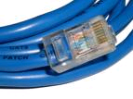
Physical media（物理媒介）
bit: propagates between transmitter/receiver pairs
physical link（物理链路）: what lies between transmitter & receiver
guided media（有向介质，有物理限制）:
signals propagate in solid media: copper, fiber, coax
unguided media（无向介质，无实体限制）:
signals propagate freely, e.g., radio
twisted pair (TP)（双绞线）
two insulated copper wires
Category 5: 100 Mbps, 1 Gbps Ethernet
Category 6: 10Gbps

Slide 34


Physical media: coax, fiber
coaxial cable（同轴电缆）:
two concentric copper conductors
bidirectional（双工）
broadband:
multiple channels on cable
HFC
fiber optic cable（光缆）:
glass fiber carrying light pulses, each pulse a bit
high-speed operation:
high-speed point-to-point transmission (e.g., 10’s-100’s Gbps transmission rate)
low error rate:
repeaters spaced far apart
immune to electromagnetic noise（电磁噪声）

Slide 35
Physical media: radio（无线电波）
signal carried in electromagnetic spectrum
no physical “wire”
bidirectional
propagation environment effects:
reflection
obstruction by objects
interference
radio link types:
terrestrial microwave（地面微波）
e.g. up to 45 Mbps channels
LAN (e.g., WiFi)
54 Mbps
wide-area (e.g., cellular)
4G cellular: ~ 10 Mbps
satellite（卫星）
Kbps to 45Mbps channel (or multiple smaller channels)
270 msec end-end delay
geosynchronous versus low altitude

Slide 36
课后作业
画出目前你正在使用的网路接入方式，并解释。
你正在给老师发送一封电子邮件，能说明邮件如何一步步被传送到了老师这里吗？

Slide 37
Chapter 1: roadmap
1.1 what is the Internet?
1.2 network edge
end systems, access networks, links
1.3 network core
packet switching（分组交换）, circuit switching（电路交换）, network structure
1.4 delay, loss, throughput in networks
1.5 protocol layers, service models
1.6 networks under attack: security
1.7 history

Slide 38







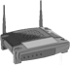

The network core
mesh of interconnected routers
packet-switching（分组交换）: hosts break application-layer messages into packets
forward packets from one router to the next, across links on path from source to destination
each packet transmitted at full link capacity

Slide 39



Packet-switching: store-and-forward （存储转发）
L bits
per packet
source
3
2
1
R bps
R bps
destination
takes L/R seconds to transmit (push out) L-bit packet into link at R bps
store and forward: entire packet must arrive at router before it can be transmitted on next link
one-hop numerical example:
L = 7.5 Mbits
R = 1.5 Mbps
one-hop transmission delay = 5 sec
end-end delay = 2L/R (assuming zero propagation delay)
more on delay shortly …

Slide 40
Packet Switching: queueing delay, loss
R = 100 Mb/s
C
A
D
R = 1.5 Mb/s
B
E
queue of packets
waiting for output link
queuing and loss:
if arrival rate (in bits) to link exceeds transmission rate of link for a period of time:
packets will queue, wait to be transmitted on link
packets can be dropped (lost) if memory (buffer) fills up

Slide 41
Two key network-core functions
routing（路由）: determines source-destination route taken by packets
routing algorithms
forwarding（转发）: move packets from router’s input to appropriate router output
routing algorithm
local forwarding table
header value
output link
0100
0101
0111
1001
3
2
2
1
1
3
2
0111
destination address in arriving
packet’s header

Slide 42
Alternative core: circuit switching（电路交换）
end-end resources allocated to, reserved for “call” between source & dest:
in diagram, each link has four circuits.
call gets 2nd circuit in top link and 1st circuit in right link.
dedicated resources: no sharing
circuit-like (guaranteed) performance
circuit segment idle if not used by call (no sharing)
commonly used in traditional telephone networks

Slide 43
Circuit switching: FDM versus TDM
Example:
FDM（频分复用）
4 users
frequency
time
TDM（时分复用）
frequency
time
Notes:
Two simple multiple access control techniques.
Each mobile’s share of the bandwidth is divided into portions for the uplink and the downlink. Also, possibly, out of band signaling.
As we will see, used in AMPS, GSM, IS-54/136

Slide 44
Packet switching versus circuit switching
packet switching allows more users to use network!
example:
1 Mb/s link
each user:
100 kb/s when “active”
active 10% of time
circuit-switching:
10 users
packet switching:
with 35 users, probability > 10 active at same time is less than .0004 *
N
users
…..
1 Mbps link
使用二项式分布计算
Q: how did we get value 0.0004?
Q: what happens if > 35 users ?
* Check out the online interactive exercises for more examples: http://gaia.cs.umass.edu/kurose_ross/interactive/

Slide 45
Packet switching versus circuit switching
is packet switching a “slam dunk winner?”
great for bursty data
resource sharing
simpler, no call setup
excessive congestion（拥塞） possible: packet delay and loss
protocols needed for reliable data transfer, congestion control
Q: How to provide circuit-like behavior?
bandwidth guarantees needed for audio/video apps
still an unsolved problem (chapter 7)
Q: human analogies of reserved resources (circuit switching) versus on-demand allocation (packet-switching)?

Slide 46
Internet structure: network of networks
End systems connect to Internet via access ISPs (Internet Service Providers，Internet提供商)
residential, company and university ISPs
Access ISPs in turn must be interconnected.
so that any two hosts can send packets to each other
Resulting network of networks is very complex
evolution was driven by economics and national policies
Let’s take a stepwise approach to describe current Internet structure

Slide 47
Internet structure: network of networks
Question: given millions of access ISPs, how to connect them together?
…
…
access
net
access
net
access
net
access
net
access
net
access
net
access
net
…
…
access
net
access
net
access
net
access
net
access
net
access
net
…
access
net
access
net
…
access
net

Slide 48
Internet structure: network of networks
Option: connect each access ISP to every other access ISP?
…
…
access
net
access
net
access
net
access
net
access
net
…
…
access
net
access
net
…
connecting each access ISP to each other directly doesn’t scale: O(N²) connections.
…
…
access
net
access
net
…
access
net
access
net
access
net
…
access
net
…
access
net
access
net
…
access
net

Slide 49
Internet structure: network of networks
Option: connect each access ISP to one global transit ISP?
Customer and provider ISPs have economic agreement.
…
…
access
net
access
net
access
net
access
net
access
net
access
net
access
net
…
…
global ISP
access
net
access
net
access
net
access
net
access
net
access
net
…
access
net
access
net
…
access
net

Slide 50
Internet structure: network of networks
But if one global ISP is viable business, there will be competitors ….
…
…
access
net
access
net
access
net
access
net
access
net
access
net
ISP A
access
net
…
…
access
net
ISP B
access
net
ISP C
access
net
access
net
access
net
access
net
…
access
net
access
net
…
access
net

Slide 51
Internet structure: network of networks
But if one global ISP is viable business, there will be competitors …. which must be interconnected
Internet exchange point
…
…
access
net
access
net
access
net
access
net
access
net
IXP
access
net
access
net
ISP A
…
…
access
net
IXP
ISP B
access
net
ISP C
access
net
access
net
peering link
access
net
access
net
…
access
net
access
net
…
access
net

Slide 52
Internet structure: network of networks
… and regional networks may arise to connect access nets to ISPs
…
…
access
net
access
net
access
net
access
net
access
net
IXP
access
net
access
net
ISP A
…
…
access
net
IXP
ISP B
access
net
ISP C
access
net
access
net
access
net
regional net
access
net
…
access
net
access
net
…
access
net

Slide 53
Internet structure: network of networks
… and content provider networks (e.g., Google, Microsoft, Akamai) may run their own network, to bring services, content close to end users
…
…
access
net
access
net
access
net
access
net
access
net
IXP
access
net
access
net
ISP A
…
…
Content provider network
access
net
IXP
ISP B
access
net
ISP C
access
net
access
net
access
net
regional net
access
net
…
access
net
access
net
…
access
net

Slide 54
Internet structure: network of networks
Tier 1 ISP
Tier 1 ISP
Google
IXP
IXP
IXP
Regional ISP
Regional ISP
access
ISP
access
ISP
access
ISP
access
ISP
access
ISP
access
ISP
access
ISP
access
ISP
at center: small # of well-connected large networks
“tier-1” commercial ISPs (e.g., Level 3, Sprint, AT&T, NTT), national & international coverage
content provider network (e.g., Google): private network that connects it data centers to Internet, often bypassing tier-1, regional ISPs

Slide 55
Tier-1 ISP: e.g., Sprint
POP：入网点
POP: point-of-presence
to/from backbone
peering
…
…
…
…
…
to/from customers

Slide 56
Chapter 1: roadmap
1.1 what is the Internet?
1.2 network edge
end systems, access networks, links
1.3 network core
packet switching, circuit switching, network structure
1.4 delay, loss, throughput in networks
1.5 protocol layers, service models
1.6 networks under attack: security
1.7 history

Slide 57
How do loss（丢包） and delay occur?
packets queue in router buffers
packet arrival rate to link (temporarily) exceeds output link capacity
packets queue, wait for turn
packet being transmitted (delay)
A
B
packets queueing (delay)
free (available) buffers: arriving packets
dropped (loss) if no free buffers

Slide 58
Four sources of packet delay
transmission
A
propagation
B
nodal
processing
queueing
d_{nodal} = d_{proc} + d_{queue} + d_{trans} + d_{prop}
d_{proc}: nodal processing
check bit errors
determine output link
typically < msec
d_{queue}: queueing delay
time waiting at output link for transmission
depends on congestion level of router

Slide 59
Four sources of packet delay
transmission
A
propagation
B
传输时延
传播时延
nodal
processing
queueing
d_{nodal} = d_{proc} + d_{queue} + d_{trans} + d_{prop}
d_{trans}: transmission delay:
L: packet length (bits)
R: link bandwidth (bps)
d_{trans} = L/R
d_{prop}: propagation delay:
d: length of physical link
s: propagation speed (~2x10⁸ m/sec)
d_{prop} = d/s
d_{trans} and d_{prop}
very different
* Check out the online interactive exercises for more examples: http://gaia.cs.umass.edu/kurose_ross/interactive/
* Check out the Java applet for an interactive animation on trans vs. prop delay

Slide 60
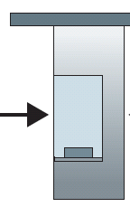
Caravan analogy
100 km
100 km
ten-car
caravan
toll
booth
toll
booth
cars “propagate” at 100 km/hr
toll booth takes 12 sec to service car (bit transmission time)
car ~ bit; caravan ~ packet
Q: How long until caravan is lined up before 2nd toll booth?
time to “push” entire caravan through toll booth onto highway = 12*10 = 120 sec
time for last car to propagate from 1st to 2nd toll both: 100km/(100km/hr)= 1 hr
A: 62 minutes

Slide 61
Caravan analogy (more)
100 km
100 km
ten-car
caravan
toll
booth
toll
booth
suppose cars now “propagate” at 1000 km/hr
and suppose toll booth（收费站） now takes one min to service a car
Q: Will cars arrive to 2nd booth before all cars serviced at first booth?
A: Yes! after 7 min, first car arrives at second booth; three cars still at first booth

Slide 62
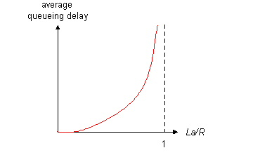

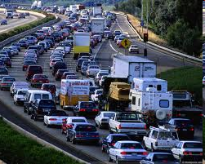
Queueing delay (revisited)
R: link bandwidth (bps)
L: packet length (bits)
a: average packet arrival rate
average queueing delay
traffic intensity La/R
流量强度
traffic intensity
= La/R
La/R ~ 0: avg. queueing delay small
La/R -> 1: avg. queueing delay large
La/R > 1: more “work” arriving
than can be serviced, average delay infinite!
La/R ~ 0
La/R -> 1
* Check online interactive animation on queuing and loss

Slide 63
“Real” Internet delays and routes
what do “real” Internet delay & loss look like?
traceroute program: provides delay measurement from source to router along end-end Internet path towards destination. For all i:
sends three packets that will reach router i on path towards destination
router i will return packets to sender
sender times interval between transmission and reply.
3 probes
3 probes
3 probes

Slide 64
“Real” Internet delays, routes
traceroute: gaia.cs.umass.edu to www.eurecom.fr
3 delay measurements from
gaia.cs.umass.edu to cs-gw.cs.umass.edu
1 cs-gw (128.119.240.254) 1 ms 1 ms 2 ms
2 border1-rt-fa5-1-0.gw.umass.edu (128.119.3.145) 1 ms 1 ms 2 ms
3 cht-vbns.gw.umass.edu (128.119.3.130) 6 ms 5 ms 5 ms
4 jn1-at1-0-0-19.wor.vbns.net (204.147.132.129) 16 ms 11 ms 13 ms
5 jn1-so7-0-0-0.wae.vbns.net (204.147.136.136) 21 ms 18 ms 18 ms
6 abilene-vbns.abilene.ucaid.edu (198.32.11.9) 22 ms 18 ms 22 ms
7 nycm-wash.abilene.ucaid.edu (198.32.8.46) 22 ms 22 ms 22 ms
8 62.40.103.253 (62.40.103.253) 104 ms 109 ms 106 ms
9 de2-1.de1.de.geant.net (62.40.96.129) 109 ms 102 ms 104 ms
10 de.fr1.fr.geant.net (62.40.96.50) 113 ms 121 ms 114 ms
11 renater-gw.fr1.fr.geant.net (62.40.103.54) 112 ms 114 ms 112 ms
12 nio-n2.cssi.renater.fr (193.51.206.13) 111 ms 114 ms 116 ms
13 nice.cssi.renater.fr (195.220.98.102) 123 ms 125 ms 124 ms
14 r3t2-nice.cssi.renater.fr (195.220.98.110) 126 ms 126 ms 124 ms
15 eurecom-valbonne.r3t2.ft.net (193.48.50.54) 135 ms 128 ms 133 ms
16 194.214.211.25 (194.214.211.25) 126 ms 128 ms 126 ms
17 * * *
18 * * *
19 fantasia.eurecom.fr (193.55.113.142) 132 ms 128 ms 136 ms
trans-oceanic
link
* means no response (probe lost, router not replying)
* Do some traceroutes from exotic countries at www.traceroute.org

Slide 65
Packet loss
queue (aka buffer) preceding link in buffer has finite capacity
packet arriving to full queue dropped (aka lost)
lost packet may be retransmitted by previous node, by source end system, or not at all
buffer
(waiting area)
A
packet being transmitted
B
packet arriving to
full buffer is lost
* Check out the Java applet for an interactive animation on queuing and loss

Slide 66
Throughput（吞吐）
throughput: rate (bits/time unit) at which bits transferred between sender/receiver
instantaneous（瞬时）: rate at given point in time
average（平均）: rate over longer period of time
server, with
file of F bits
to send to client
link capacity
R_{s} bits/sec
link capacity
R_{c} bits/sec
server sends bits
(fluid) into pipe
pipe that can carry
fluid at rate
R_{s} bits/sec)
pipe that can carry
fluid at rate
R_{c} bits/sec)

Slide 67
Throughput (more)
R_{s} < R_{c} What is average end-end throughput?
R_{s} bits/sec
R_{c} bits/sec
R_{s} > R_{c} What is average end-end throughput?
R_{s} bits/sec
R_{c} bits/sec
bottleneck link
link on end-end path that constrains end-end throughput

Slide 68
Throughput: Internet scenario
per-connection end-end throughput: min(R_{c},R_{s},R/10)
in practice: R_{c} or R_{s} is often bottleneck
R_{s}
R_{s}
R_{s}
R
R_{c}
R_{c}
R_{c}
10 connections (fairly) share backbone bottleneck link R bits/sec
* Check out the online interactive exercises for more examples: http://gaia.cs.umass.edu/kurose_ross/interactive/

Slide 69
课堂作业
华东师范大学数据学院和新疆石河子大学的计算机科学与技术学院对口帮扶。
我们也鼓励同年级的班级的同学们之间也建立良好的互助关系。
假设每个月同学们会互相邮寄一些书籍或者其他学习用品。
请说明从华师大数据学院的二年级A班同学张大鹏到新疆石河子大学二年级A班李小明的包裹邮寄和传递过程

Slide 70
Chapter 1: roadmap
1.1 what is the Internet?
1.2 network edge
end systems, access networks, links
1.3 network core
packet switching, circuit switching, network structure
1.4 delay, loss, throughput in networks
1.5 protocol layers, service models
1.6 networks under attack: security
1.7 history

Slide 71
Protocol “layers”
Networks are complex,
with many “pieces”:
hosts
routers
links of various media
applications
protocols
hardware, software
Question:
is there any hope of organizing structure of network?
…. or at least our discussion of networks?

Slide 72
Organization of air travel
ticket (purchase)
baggage (check)
gates (load)
runway takeoff
airplane routing
ticket (complain)
baggage (claim)
gates (unload)
runway landing
airplane routing
airplane routing
a series of steps
票务（购买），行李（拖运），登机口（登机），从跑道起飞，按路线飞行，按路线飞行，从跑道着陆，登机口（离机），行李（认领），票务（投诉）

Slide 73
Layering of airline functionality
ticket (purchase)
baggage (check)
gates (load)
runway (takeoff)
airplane routing
ticket (complain)
baggage (claim
gates (unload)
runway (land)
airplane routing
ticket
baggage
gate
takeoff/landing
airplane routing
airplane routing
airplane routing
departure
airport
intermediate air-traffic
control centers
arrival
airport
layers: each layer implements a service
via its own internal-layer actions
relying on services provided by layer below

Slide 74
Why layering?
dealing with complex systems:
explicit structure allows identification, relationship of complex system’s pieces
layered reference model for discussion
modularization eases maintenance, updating of system
change of implementation of layer’s service transparent（透明） to rest of system
e.g., change in gate procedure doesn’t affect rest of system
layering considered harmful?

Slide 75
Internet protocol stack（协议栈）
application（应用层）: supporting network applications
FTP, SMTP, HTTP 报文
transport（传输层）: process-process data transfer
TCP, UDP 报文段
network（网络层）: routing of datagrams from source to destination
IP, routing protocols 数据报
link（链路层）: data transfer between neighboring network elements
Ethernet, 802.111 (WiFi), PPP
physical（物理层）: bits “on the wire”
application
transport
network
link
physical

Slide 76
ISO/OSI reference model
presentation（表示层）: allow applications to interpret meaning of data, e.g., encryption, compression, machine-specific conventions
session（会话）: synchronization（同步）, checkpointing（检查点）, recovery of data exchange
Internet stack “missing” these layers!
these services, if needed, must be implemented in application
needed?
application
presentation
session
transport
network
link
physical

Slide 77
Encapsulation
source
message
M
application
transport
network
link
physical
segment
H_{t}
M
H_{t}
datagram
H_{n}
H_{n}
H_{t}
M
frame
H_{l}
H_{n}
H_{t}
M
link
physical
switch
destination
H_{n}
H_{t}
M
network
link
physical
M
application
transport
network
link
physical
H_{l}
H_{n}
H_{t}
M
H_{n}
H_{t}
M
H_{t}
M
H_{n}
H_{t}
M
H_{l}
H_{n}
H_{t}
M
router

Slide 78
Chapter 1: roadmap
1.1 what is the Internet?
1.2 network edge
end systems, access networks, links
1.3 network core
packet switching, circuit switching, network structure
1.4 delay, loss, throughput in networks
1.5 protocol layers, service models
1.6 networks under attack: security
1.7 history

Slide 79
Network security（网络安全）
field of network security:
how bad guys can attack computer networks
how we can defend networks against attacks
how to design architectures that are immune to attacks
Internet not originally designed with (much) security in mind
original vision: “a group of mutually trusting users attached to a transparent network” ☺
Internet protocol designers playing “catch-up”
security considerations in all layers!

Slide 80
Bad guys: put malware(恶意软件) into hosts via Internet
malware can get in host from:
virus: self-replicating infection by receiving/executing object (e.g., e-mail attachment)
worm: self-replicating infection by passively receiving object that gets itself executed
spyware malware can record keystrokes, web sites visited, upload info to collection site
infected host can be enrolled in botnet, used for spam. DDoS attacks

Slide 81
Bad guys: attack server, network infrastructure
Denial of Service (DoS)拒绝服务攻击: attackers make resources (server, bandwidth) unavailable to legitimate traffic by overwhelming resource with bogus traffic
1. select target
2. break into hosts around the network (see botnet 僵尸网络)
3. send packets to target from compromised hosts
target

Slide 82
Bad guys can sniff packets
packet “sniffing”（分组嗅探）:
broadcast media (shared Ethernet, wireless)
promiscuous network interface reads/records all packets (e.g., including passwords!) passing by
A
C
src:B dest:A payload
B
wireshark software used for end-of-chapter labs is a (free) packet-sniffer

Slide 83
Bad guys can use fake addresses
IP spoofing（IP 哄骗）: send packet with false source address
A
C
src:B dest:A payload
B
… lots more on security (throughout, Chapter 8)

Slide 84
Chapter 1: roadmap
1.1 what is the Internet?
1.2 network edge
end systems, access networks, links
1.3 network core
packet switching, circuit switching, network structure
1.4 delay, loss, throughput in networks
1.5 protocol layers, service models
1.6 networks under attack: security
1.7 history

Slide 85
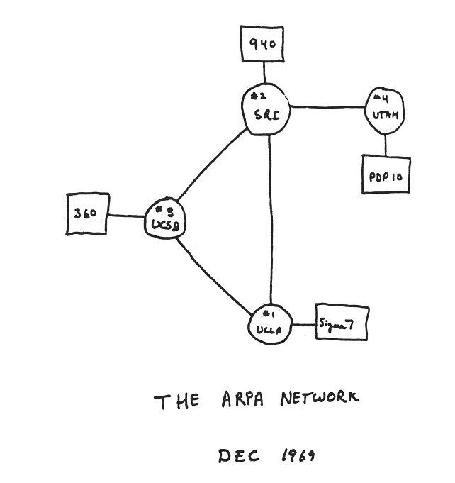
Internet history
1961-1972: Early packet-switching principles
1961: Kleinrock - queueing theory shows effectiveness of packet-switching
1964: Baran - packet-switching in military nets
1967: ARPAnet conceived by Advanced Research Projects Agency
1969: first ARPAnet node operational
1972:
ARPAnet public demo
NCP (Network Control Protocol) first host-host protocol
first e-mail program
ARPAnet has 15 nodes

Slide 86
Internet history
1972-1980: Internetworking, new and proprietary nets
1970: ALOHAnet satellite network in Hawaii
1974: Cerf and Kahn - architecture for interconnecting networks
1976: Ethernet at Xerox PARC
late70’s: proprietary architectures: DECnet, SNA, XNA
late 70’s: switching fixed length packets (ATM precursor)
1979: ARPAnet has 200 nodes
Cerf and Kahn’s internetworking principles:
minimalism, autonomy - no internal changes required to interconnect networks
best effort service model
stateless routers
decentralized control
define today’s Internet architecture

Slide 87
Internet history
1980-1990: new protocols, a proliferation of networks
1983: deployment of TCP/IP
1982: smtp e-mail protocol defined
1983: DNS defined for name-to-IP-address translation
1985: ftp protocol defined
1988: TCP congestion control
new national networks: CSnet, BITnet, NSFnet, Minitel
100,000 hosts connected to confederation of networks

Slide 88
Internet history
1990, 2000’s: commercialization, the Web, new apps
early 1990’s: ARPAnet decommissioned
1991: NSF lifts restrictions on commercial use of NSFnet (decommissioned, 1995)
early 1990s: Web
hypertext [Bush 1945, Nelson 1960’s]
HTML, HTTP: Berners-Lee
1994: Mosaic, later Netscape
late 1990’s: commercialization of the Web
late 1990’s – 2000’s:
more killer apps: instant messaging, P2P file sharing
network security to forefront
est. 50 million host, 100 million+ users
backbone links running at Gbps

Slide 89
Internet history
2005-present
~5B devices attached to Internet (2016)
smartphones and tablets
aggressive deployment of broadband access
increasing ubiquity of high-speed wireless access
emergence of online social networks:
Facebook: ~ one billion users
service providers (Google, Microsoft) create their own networks
bypass Internet, providing “instantaneous” access to search, video content, email, etc.
e-commerce, universities, enterprises running their services in “cloud” (e.g., Amazon EC2)

Slide 90
Introduction: summary
covered a “ton” of material!
Internet overview
what’s a protocol?
network edge, core, access network
packet-switching versus circuit-switching
Internet structure
performance: loss, delay, throughput
layering, service models
security
history
you now have:
context, overview, “feel” of networking
more depth, detail to follow!

Slide 91
课后习题
P1，P3，P9，P12, P20，P22
在下周五上课之前在钉钉群以作业的方式提交

Slide 92
Chapter 1 Additional Slides

Slide 93

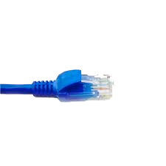
application
(www browser,
email client)
packet
analyzer
application
OS
packet
capture
(pcap)
Transport (TCP/UDP)
Network (IP)
Link (Ethernet)
Physical
copy of all Ethernet frames sent/received

